Slide 1

HamSCI
Meteor Scatter Working Group
Oct 28, 2026
Rob Suggs Ph.D. , NN4NT
NASA Marshall Space Flight Center Amateur Radio Club
and
The HamSCI Community
nn4nt@outlook.com
robert.suggs@scranton.edu
Jay Weitzen Ph.D. , AC1SN
University of Massachusetts - Lowell
and
The HamSCI Community
jay_weitzen@uml.edu
jay.weitzen@scranton.edu

Slide 2
Agenda
Announcements
Action Item Review
HamSCI Workshop planning – Nathaniel Frissell
Scattering geometry visualization – Tom McMahan
Haystack Digital RF data format – Ryan Volz
Status of CW beacon testing – Jay Wilson
RF Sources for meteor detection – Rob Suggs
Possible tutorials on:
Shower modeling – Cooke/MEO – Nov 18
CMOR radar – Brown/UWO – Dec 2 ?
Sporadic modeling/Meteoroid Engineering Model – Cooke/MEO – Jan ?
PHARLAP/PyLAP capabilities – Hozumi – Jan 6 ?
Suggestions for future topics ?

Slide 3
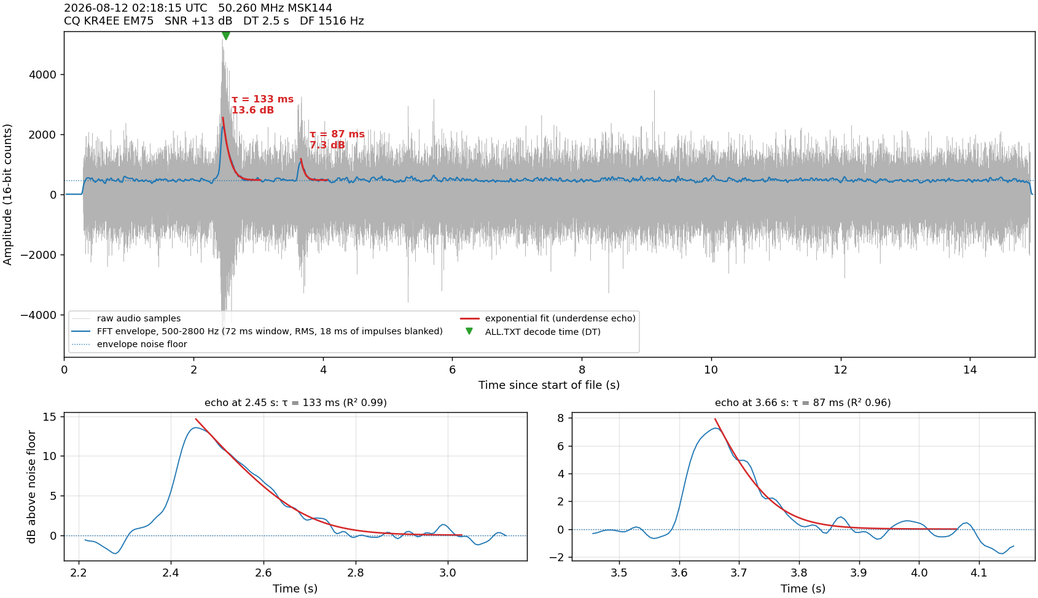

Slide 4
Announcements

Slide 5
Action Item Review
Number | Actionee | Due Date | Description | Status
1 | Jay Weitzen | 9/23 | Investigate 1 sec Kostas coding (talk to David)
11 | Rob Suggs | 10/21 | Contact Scranton Tech Support regarding Sharepoint use | Emailed 10/25, waiting to hear. #1160387. Iterating with IT
12 | Robert Hipple | 11/4 | Work through the upload process for SIGMOND MSK144 WAV files
13 | Robert Hipple |  | Consider a dashboard to explore SIGMOND meteor scatter output. Include Tom’s ellipsoid visualization software and raytracing capability.
14
15
16
17
18
19
20

Slide 6
Scattering Geometry Visualization - McMahan

Slide 7
Haystack Digital RF - Volz

Slide 8
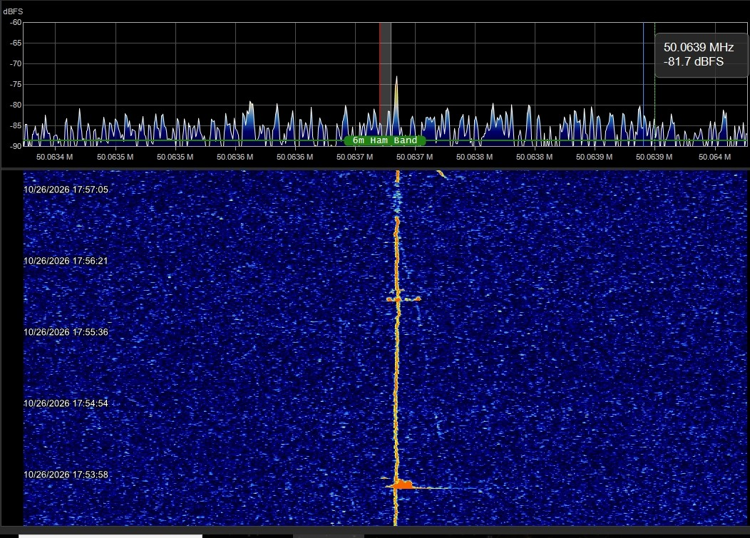
CW Beacon Testing - Wilson
I will miss tomorrow's meeting as I will be without cell service driving from Los Alamos to Socorro.
If Ted Cline checks in, he can probably share updates on our new beacon location. We have very encouraging initial reports on solid .meteor reflections.
Also, we now have nine kilowatt amplifiers for 6 meters available.
We can use input and suggestions from the group on what transmitters to use as drivers. We have three Kenwood TS-511 but frequency stability is not ideal. Chip Sufitchi can speak to that.
Affordability is a concern unless we can find an additional source of funds.
Next, we need partners willing to host a beacon.
I should make next week's meeting.
- Jay. Wilson W0AIR

Slide 9
RF Sources for Meteor Scatter - Suggs
RF Sources for Meteor Radar
Suggs 10/23/26 |  |  |  |  | Utility for Meteor Science
Source | Freq Range | Power level | Notes | Modulation | Pros | Cons | Compatible Software
Amateur MSK144 | 28, 50, 144 MHz | <1500 W | Most are 100 W and small antennas | MSK144 | Messages contain source callsign and location | Only available when someone is transmitting | WSJT-X, Sigmond
 |  |  |  | MSK (a form of OQPSK) |  | No way to measure doppler
Digital Television Pilot Tone | 54 - 88 MHz | ? |  | CW | Available 24/7 | Determining TX location for each audio freq can be difficult | NASA Counting Software
 |  |  |  |  | Different TX are slightly separated in RX audio passband | Fairly weak, tone is tiny fraction of transmitter power
Amateur CW beacons | TBD | 30 - 1500 W |  | CW | Available 24/7 |  | To be developed
May be licensed for other frequencies and higher power |  |  |  |  |  |  | See Balis+ 2025
Professional meteor radars | 17.45, 29.85, 38.15 MHz | 15 - 130 kW | CMOR | Pulsed 532 Hz, 70 μsec | Available 24/7 | Processing complexity | To be developed
 |  |  |  |  | We know their locations
 | 31.65 MHz | 500 W | SIMONe | coded CW

Slide 10
Backup

Slide 11
Homework – Read/view the following
Weitzen and Ralston MS review paper https://github.com/HamSCI/MSQP/blob/main/Weitzen_and_Ralston_Meteor_scatter_an_overview.pdf
Suggs’ HamSCI talk/slides https://www.hamsci.org/sites/default/files/article/Workshop_2026/Meteor_Scatter_Science_Behind_the_Pings_HamSCI_conference_RevB.pdf
https://www.youtube.com/watch?v=1pgrXqg435g&t=3s
Balis+ – example of what can be done with CW forward scatter
McKinley chapters - contact Rob Suggs for copies
MSK144 Protocol https://github.com/HamSCI/MSQP/blob/main/MSK144_Protocol_QEX.pdf
CMOR radar info https://aquarid.physics.uwo.ca/research/radar/cmor_intro.html

